Slide 1
Nested/Embedded Documents

Slide 2
Nested/Embedded Documents
It contain a document inside another document.
When a collection has a document, this document contains another document, another document contains another sub-document, and so on, then such types of documents are known as embedded or nested documents.

Slide 3
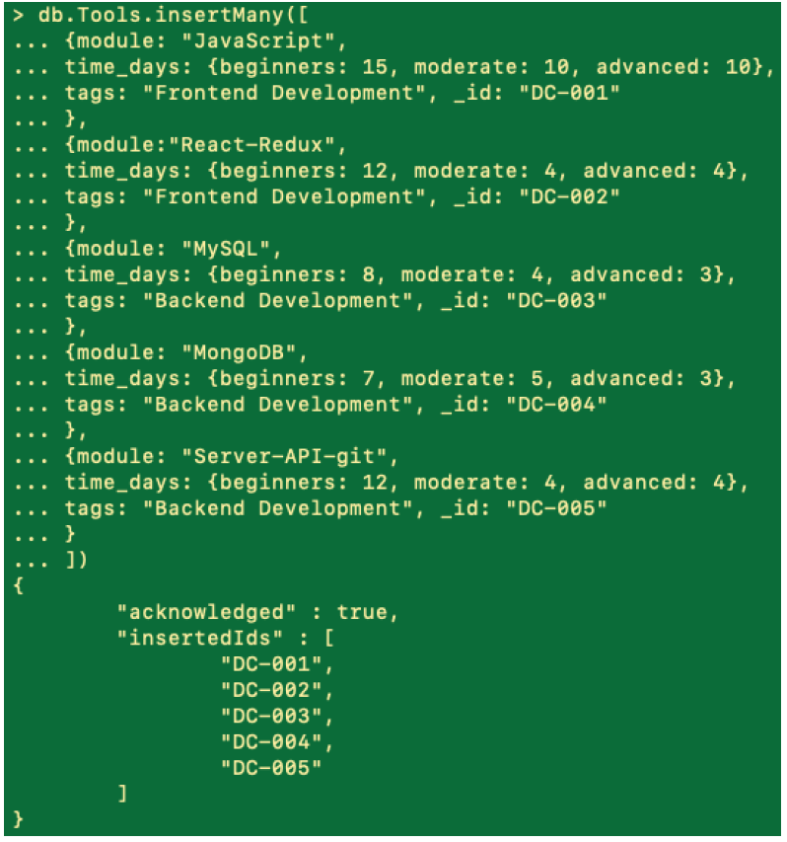

Slide 4
Query on Nested Documents
An embedded document can be accessed by using the .find() method and using dot notation in our query filter to access the embedded field.
Syntax: "field.nestedField": value

Slide 5
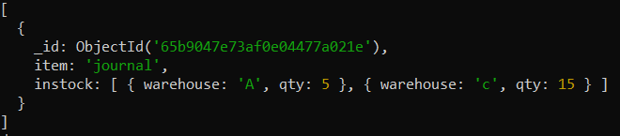
Example: db.inventory.insertMany( [
{ item: "journal", instock: [ { warehouse: "A", qty: 5 }, { warehouse: "C", qty: 15 } ] },
{ item: "notebook", instock: [ { warehouse: "C", qty: 5 } ] }
]);
Query for a Document Nested in an Array:
Output:
Equality matches on the whole embedded/nested document require an exact match of the specified document, including the field order. For example, the following query does not match any documents in the inventory collection:

Slide 6
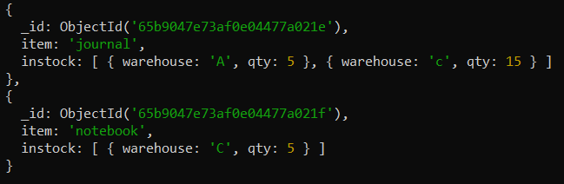
Specify a Query Condition on a Field Embedded in an Array of Documents
Example: db.First_Collection.insertMany( [
{ item: "journal", instock: [ { warehouse: "A", qty: 5 }, { warehouse: "C", qty: 15 } ] },
{ item: "notebook", instock: [ { warehouse: "C", qty: 5 } ] },
]);
This query selects all documents where the instock array has at least one embedded document that contains the field qty whose value is less than or equal to 10.

Slide 7
Use the Array Index to Query for a Field in the Embedded Document
Using dot notation, you can specify query conditions for field in a document at a particular index or position of the array. The array uses zero-based indexing.
When querying using dot notation, the field and index must be inside quotation marks.
This query selects all documents where the instock array has as its first element a document that contains the field qty whose value is less than or equal to 20.
db.inventory.insertMany( [
{ item: "journal", instock: [ { warehouse: "A", qty: 5 }, { warehouse: "C", qty: 15 } ] },
{ item: "notebook", instock: [ { warehouse: "C", qty: 5 } ] },
{ item: "paper", instock: [ { warehouse: "A", qty: 60 }, { warehouse: "B", qty: 15 } ] },
{ item: "planner", instock: [ { warehouse: "A", qty: 40 }, { warehouse: "B", qty: 5 } ] },
{ item: "postcard", instock: [ { warehouse: "B", qty: 15 }, { warehouse: "C", qty: 35 } ] }
]);

Slide 8
db.First_Collection.insertMany( [
{ item: "journal", instock: [ { warehouse: "A", qty: 5 }, { warehouse: "C", qty: 15 } ] },
{ item: "notebook", instock: [ { warehouse: "C", qty: 5 } ] },
]);
Query 1:
Query 2:

Slide 9
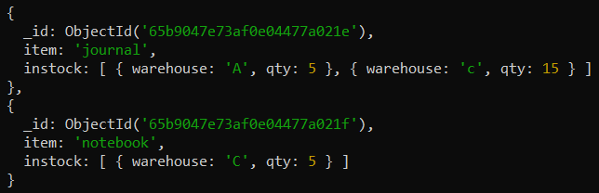
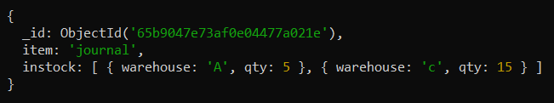
db.First_Collection.insertMany( [
{ item: "journal", instock: [ { warehouse: "A", qty: 5 }, { warehouse: "C", qty: 15 } ] },
{ item: "notebook", instock: [ { warehouse: "C", qty: 5 } ] },
]);
Query 1:
Output:
Query 2:
Output:

Slide 10
Specify Multiple Conditions for an Array of Documents
When specifying conditions on more than one field nested in an array of documents, you can specify the query such that either a single document meets these condition or any combination of documents (including a single document) in the array meets the conditions.
A Single Nested Document Meets Multiple Query Conditions on Nested Fields
Use $elemMatch operator to specify multiple criteria on an array of embedded documents such that at least one embedded document satisfies all the specified criteria.
db.inventory.insertMany( [
{ item: "journal", instock: [ { warehouse: "A", qty: 5 }, { warehouse: "C", qty: 15 } ] },
{ item: "notebook", instock: [ { warehouse: "C", qty: 5 } ] }
]);

Slide 11
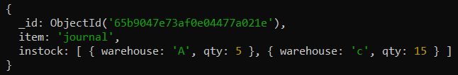
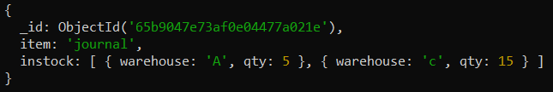
db.inventory.insertMany( [
{ item: "journal", instock: [ { warehouse: "A", qty: 5 }, { warehouse: "C", qty: 15 } ] },
{ item: "notebook", instock: [ { warehouse: "C", qty: 5 } ] }
]);
This example queries for documents where the instock array has at least one embedded document that contains both the field qty equal to 5 and the field warehouse equal to A.
This example queries for documents where the instock array has at least one embedded document that contains the field qty that is greater than 10 and less than or equal to 20.
Output:
Output:

Slide 12
Combination of Elements Satisfies the Criteria
If the compound query conditions on an array field do not use the $elemMatch operator, the query selects those documents whose array contains any combination of elements that satisfies the conditions.
Example:
db.inventory.insertMany( [
{ item: "journal", instock: [ { warehouse: "A", qty: 5 }, { warehouse: "C", qty: 15 } ] },
{ item: "notebook", instock: [ { warehouse: "C", qty: 5 } ] },
{ item: "paper", instock: [ { warehouse: "A", qty: 60 }, { warehouse: "B", qty: 15 } ] },
{ item: "planner", instock: [ { warehouse: "A", qty: 40 }, { warehouse: "B", qty: 5 } ] },
{ item: "postcard", instock: [ { warehouse: "B", qty: 15 }, { warehouse: "C", qty: 35 } ] }
]);
This query matches documents where any document nested in the instock array has the qty field greater than 10 and any document (but not necessarily the same embedded document) in the array has the qty field less than or equal to 20.

Slide 13
db.inventory.insertMany( [
{ item: "journal", instock: [ { warehouse: "A", qty: 5 }, { warehouse: "C", qty: 15 } ] },
{ item: "notebook", instock: [ { warehouse: "C", qty: 5 } ] },
{ item: "paper", instock: [ { warehouse: "A", qty: 60 }, { warehouse: "B", qty: 15 } ] },
{ item: "planner", instock: [ { warehouse: "A", qty: 40 }, { warehouse: "B", qty: 5 } ] },
{ item: "postcard", instock: [ { warehouse: "B", qty: 15 }, { warehouse: "C", qty: 35 } ] }
]);
This example queries for documents where the instock array has at least one embedded document that contains the field qty equal to 5 and at least one embedded document (but not necessarily the same embedded document) that contains the field warehouse equal to A.

